Slide 1

ELECTRONIC PRODUCTS REVENUE ANALYSIS
Naveen Ramesh
BADM-WD-T-B5

Slide 2

Problem Statement:
Analyze Retail Sales Data To Extract Actionable Business Insights And Provide Recommendations Based On The Analysis using MySQL.

Slide 3
Dataset cleaning
The Dataset Includes Retail Sales Transactions. Key Variables Include:
Order ID(Variable): Unique Identifier For Each Transaction
Product(Variable): Name Of The Product Sold
Quantity Ordered(Integer): Number Of Units Sold In The Transaction
Price Each(Decimal): Price Per Unit Of The Product
Order Date(Date Time): Date And Time Of The Transaction
Purchase Address(Variable): Address Where The Product Was Delivered.
Month(Integer): Months where the sales made
City(Variable): Cities where the sales made
Sales Made(Decimal): Combination of quantity ordered and price each.
Data Cleaning Was Done Via Ms-excel: Null Rows Were Removed, Repetition Of Header Was Removed.
Month, City And Sales-made Columns Were Created.
Then the Excel.CSV file was imported in the MySql workbench.
Attached below the updated processed data.

Slide 4
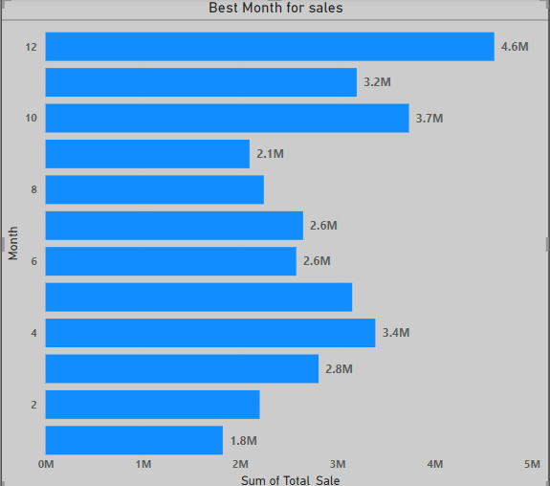
Data Analysis using SQL best month for sales and the total earnings
From The Analysis We Can Find That,
December Month Has The Best Sales With Revenue More Than 4.6 Million And The Lowest Is January With 1.8M Revenue
There Is Rise In Sales Till April
There Is A Continuous Drop After October.
MySQL Query;
SELECT Month,
Sum(sales_made) AS Total_sales
From Electronic_sales_data.Electronics_retail_data
Group BY Month
Order BY Total_sales DESC;

Slide 5
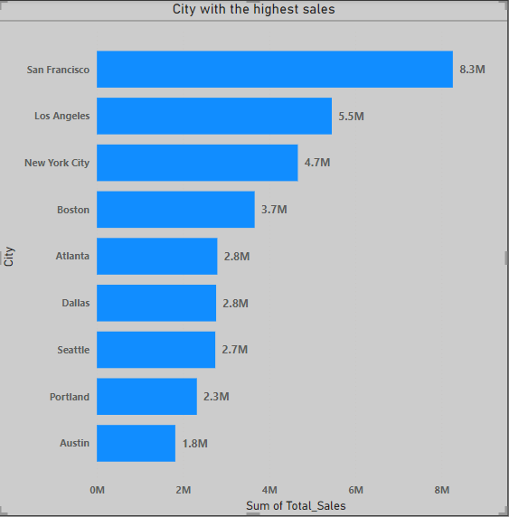
the city with the highest sales
From The Analysis We Can Find That,
San Francisco Has The Highest Sales, Followed By Los Angeles And New York City. City With The Lowest Sales Was Austin.
MySQL Query;
Select City,sum(sales_made) As Total_sales
from Electronic_sales_data.Electronics_retail_data
group By city
order By
total_sales DESC;

Slide 6
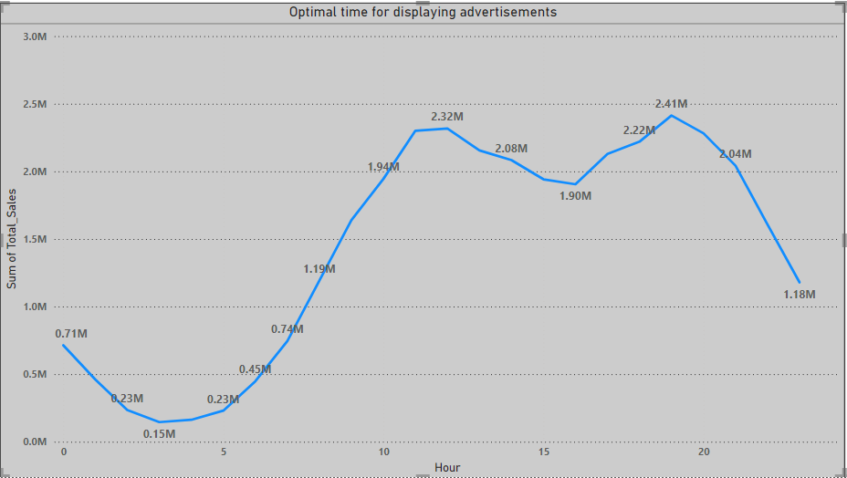
optimal time for displaying advertisements
From The Analysis We Can Find That,
It Is Recommended To Advertise Around 12th Or Around 19th Hour.
Mysql Query;
Select
hour(order_date) AS Hour,
sum(sales_made) AS Total_sales
From electronic_sales_data.Electronics_retail_data
group By hour(order_date)
order By
total_sales DESC;

Slide 7
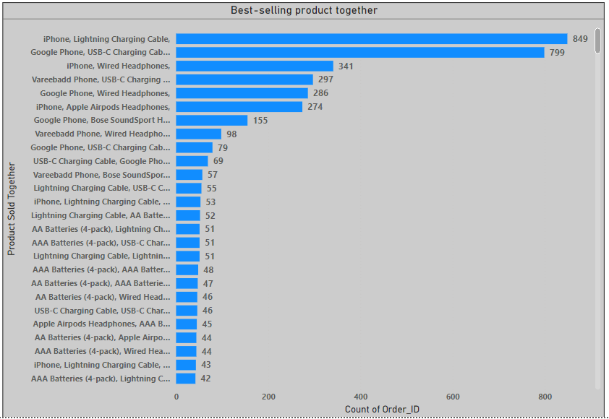
frequently bought products Together
From The Analysis We Can Find That,
'I-phone' And 'Lighting Charging Cable' Were The Top Most Products Sold Together.
'Google Phone', 'Usb-c Charging Cable' And 'Iphone', 'Wired Headphones' Were Among The Top Most Products Sold Together.
Mysql Query;
Select
Order_id,
Group_concat(product SEPARATOR ',') AS Productssoldtogether
FROM Electronic_sales_data.Electronics_retail_data
Group By
Order_id
Having
Count(product) > 1;

Slide 8
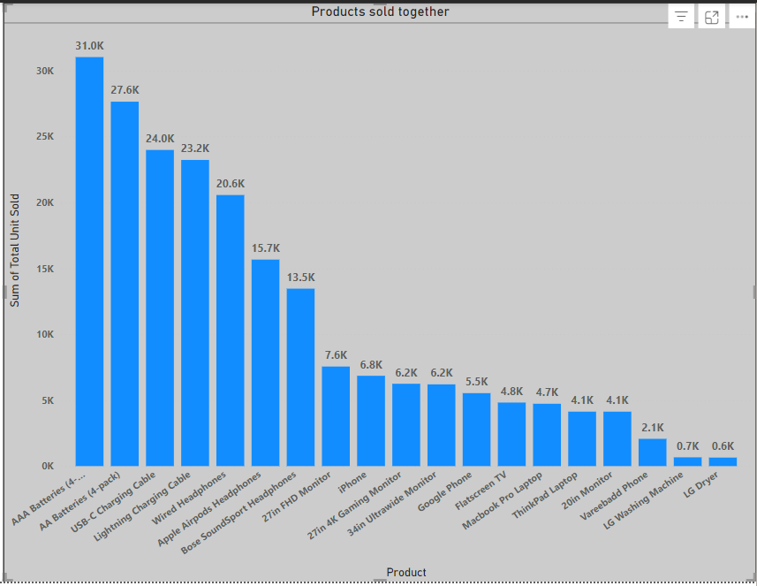
best-selling product and reason for its success
From The Analysis We Can Find That,
AA Batteries (4-pack) Is The Most Sold Product.
Least is LG Dryer
Mysql Query;
Select
Product,
Sum(quantity_ordered) AS Totalunitssold
FROM Electronic_sales_data.Electronics_retail_data
GROUP BY Product
ORDER BY
Totalunitssold DESC;

Slide 9
Recommendations
From the above analysis, recommendations are made below,
There Is Rise In Sales Till April. There Is A Continuous Drop Before October. So, The Business And Marketing Campaigns Can Be Made Between April And October
Based On The Above Results, Cities Which Are At The Coast Have Higher Revenue And Cities Which Have Major Tech Advancements Which Need Electronics Components Have Higher Sales.
There Is The Dip In Sales From 1st Hour Till 11th And From 13th To 17th Hour. It Is Recommended To Advertise Around 12th Or Around 19th Hour, Because There Is More Active Consumers.
'Google Phone', 'Usb-c Charging Cable' And 'Iphone', 'Wired Headphones' Were Among The Top Most Products Sold Together. Least Is Different Batteries.
By Correlating Products' Quantity With Price Of The Quantity, If The Product Is Costlier, Then The Quantity Ordered Is Less. If The Product Is Cheaper, Then The Quantity Ordered Is More.

Slide 10

Conclusion
By this project;
Key Sales Trends And Patterns Are Identified.
Insights For Strategic Decision-making In Retail Is Generated.
Present Findings In A Clear, Actionable Format Are Made.

Slide 11
Thank You!

